Slide 1

CS1010: Programming Methodology
Week 4
Recap

Slide 2
if-else Statements
if (n == 0) {
answer = 1;
} else {
answer = n * factorial(n - 1);
}
true
exp?
false
if (max_so_far < x) {
max_so_far = x; // update max
}
true
exp?
false

Slide 3
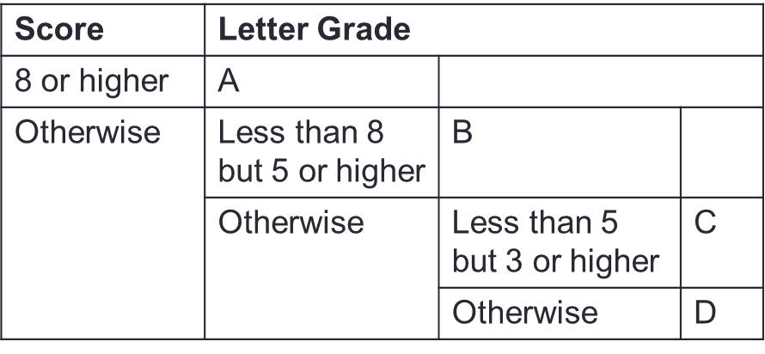
Nested if-else Statements
  Problem: Print a letter grade based on a score
…
if (score >= 8) {
// print "A"
} else {
if (score >= 5) {
// print "B"
} else {
if (score >= 3) {
// print "C"
} else {
// print "D"
}
}
}
…

Slide 4
if-(else-if-)else… Statements
  Problem: Print a letter grade based on a score
…
if (score >= 8) {
// print "A"
} else if (score >= 5) {
// print "B"
} else if (score >= 3) {
// print "C"
} else {
// print "D"
}
…
Do NOT omit {}, otherwise you might run into strange errors.
Score | Letter Grade
8 or higher | A
Less than 8 but 5 or higher | B
Less than 5 but 3 or higher | C
Less than 3 | D

Slide 5
Ex#1: CS1010 Schedule
Problem: Print the CS1010 schedule based on day (1/2/3/4/5) and time (1000/1100/…)
 | 1000 | 1100 | 1200 | 1300 | 1400 | 1500 | 1600 | 1700
1 (Mon) | Tutorial | Tutorial | Tutorial | Tutorial | Lecture | Lecture | - | -
2 (Tue) | - | - | - | - | - | - | - | -
3 (Wed) | - | - | Tutorial | Tutorial | Tutorial | Tutorial | - | -
4 (Thu) | - | - | - | - | - | - | - | -
5 (Fri) | - | - | - | - | - | - | - | -
 | Activity
day is 2/4/5 | No activity
Otherwise | day is 3 | time is between 1200-1600 | Tutorial
 |  | Otherwise | No activity
 | Otherwise | time is between 1000-1400 | Tutorial
 | Less than 3 | time is between 1400-1600 | Lecture
 |  | Otherwise | No activity

Slide 6
Ex#1: CS1010 Schedule
Problem: Print the CS1010 schedule based on day (1/2/3/4/5) and time (1000/1100/…)
 | 1000 | 1100 | 1200 | 1300 | 1400 | 1500 | 1600 | 1700
1 (Mon) | Tutorial | Tutorial | Tutorial | Tutorial | Lecture | Lecture | - | -
2 (Tue) | - | - | - | - | - | - | - | -
3 (Wed) | - | - | Tutorial | Tutorial | Tutorial | Tutorial | - | -
4 (Thu) | - | - | - | - | - | - | - | -
5 (Fri) | - | - | - | - | - | - | - | -
 | Activity
day is 1 and time is between 1000-1400 | Tutorial
day is 1 and time is between 1400-1600 | Lecture
day is 3 and time is between 1200-1600 | Tutorial
Otherwise | No activity

Slide 7
Boolean Values
Data type: bool (requires stdbool.h)
bool is_diff = x != y; // evaluates to true or false
if (is_diff) {
cs1010_println_string("x and y
store different values.");
} else {
cs1010_println_string("x and y
store the same value.");
}

Slide 8
Boolean Values
Data type: bool (requires stdbool.h)
…
int main(){
…
if (is_diff(x, y)) {
cs1010_println_string("x and y
store different values.");
} else {
cs1010_println_string("x and y
store the same value.");
}
…
}
bool is_diff(long x, long y)
{
return x!=y;
}

Slide 9
Logical Operators
For combining two or more Boolean values.
Examples:
  If the birth year of a person is between 1995 and 2005, this person is Generation Z → (birth_year >= 1995) && (birth_year <= 2005)
  If the birth year of a person is either before 1995 or after 2005, this person is not Generation Z → (birth_year < 1995) || (birth_year > 2005)
Logical operators: && (and), || (or), ! (not).
A | B | A && B | A || B | !A
False | False | False | False | True
False | True | False | True | True
True | False | False | True | False
True | True | True | True | False

Slide 10

Common Mistakes
Common Mistakes
if (n = 0) …
This assigns 0 to n instead.
double expected_value = 0.3;
double sum = 0.1 + 0.2;
if (sum == expected_value) { : }
The expression could be false since not all real numbers can be represented accurately.
…
if ((sum <= expected_value + 0.01) &&
(sum >= expected_value - 0.01))…
Allow for inaccuracy in the computation.
if ((expected_value – 0.01) <= sum <=
(expected_value + 0.01)…
This does not work either due to associativity.

Slide 11
Short-Circuit Evaluation
expr1 && expr2
  If expr1 is false, skip evaluating expr2 and return false immediately, as the result will always be false.
  Example: (birth_year >= 1995) && (birth_year <= 2005)
expr1 || expr2
  If expr1 is true, skip evaluating expr2 and return true immediately, as the result will always be true.
  Example: (birth_year < 1995) || (birth_year > 2005)
Make things faster in some cases
  Example: has_been_overseas_recently(person) ||
  is_tested_positive(person)

Slide 12
Assertion
Important: Write an assertion based on what should be true, not your code!
Problem: Find the maximum value between two variables
if (…) {
// { x > y }
…
// {max == x && max > y}
else {
// { x <= y }
…
// {max >= x && max == y}
}
x > y
x <= y

Slide 13
Clarify your doubts before it is too late!

